Slide 1
Vibe Wave
SUBMITTED BY:
Yugesh A, Karan K, Vengateshwaran M
242237, 242222, 242236
I B.Sc CS (Data Science & Analytics)

Slide 2
abstract
Vibe Wave is a music management platform that enables users to upload, store, and access their songs seamlessly across multiple devices. Designed with a user-friendly interface, it offers a website for enhanced accessibility. Users can create profiles, upload their own songs, and download their music on any logged-in device. The platform ensures secure file management and authentication using Python and/or Node Js for backend operations and MongoDB for data storage. Vibe Wave follows a subscription-based model, providing different storage and feature options, including a free plan with limited storage and premium plans for expanded access. With a design inspired by leading music platforms, Vibe Wave aims to deliver a smooth and efficient music experience.

Slide 3
System Analysis
Existing System
Major platforms like Spotify, Apple Music, YouTube Music, SoundCloud dominate the music streaming market, each with unique strength.
While Spotify and Apple Music offer vast libraries and premium features, they lack user-upload options.
Proposed System
Vibe Wave is a music storage and streaming platform designed to give users complete control over their personal music collection..
Unlike traditional streaming services Vibe Wave allows users to upload, manage, and access their own songs anytime.

Slide 4
EXISTING SYSTEM DRAWBACKS:
1. Limited User Control:
Users cannot upload and store their own music for easy access across multiple devices.
Music libraries are controlled by platforms, restricting personalization.
2. Lack of Personal Music Creation Features:
No option to save, or manage personal audio samples for future song creation.
Users rely on external software for storing their own music.
3. Storage Limitations & Expensive Premium Plans
Free plans offer very limited storage, restricting user uploads.
Paid plans are often expensive with no affordable mid-tier options.

Slide 5
PROPOSED SYSTEM ADVANTAGES:
1. Personalized Music Storage
Users can upload, store, and access their own music files from any device.
Provides a dedicated cloud storage system for personal music collections.
2. Offline Access & Seamless Playback
Users can download their uploaded songs for offline listening without restrictions.
Music can be played anytime, anywhere, without requiring an internet connection.
3. Sample Storage
Enables users to save, and manage their own audio samples.
Helps aspiring musicians store ideas and create their own tracks

Slide 6
System Requirements
Hardware Requirements:
Device: Desktop, laptop, tablet, or smartphone
Processor: Dual-core or higher
Memory: 4 GB RAM or higher
Storage: 128 GB or higher
Operating System: Windows, macOS, or mobile OS (Android or iOS)
Software Requirements:
Operating System: Windows, macOS, or Linux
Programming Language: Node.js
Database: MongoDB
Frontend: HTML, CSS, JavaScript
IDE/Editor: Visual Studio Code, or any text editor

Slide 7
Module Descriptions
Module 1: User Registration and Login
Create accounts and securely log in.
Module 2: Music Streaming & Playback
Provides a seamless music playback experience.
Module 3: User Dashboard
Displays user data and activity in an interactive dashboard.
Module 4: Music Upload & Storage
Enables users to upload and manage their personal music files.

Slide 8
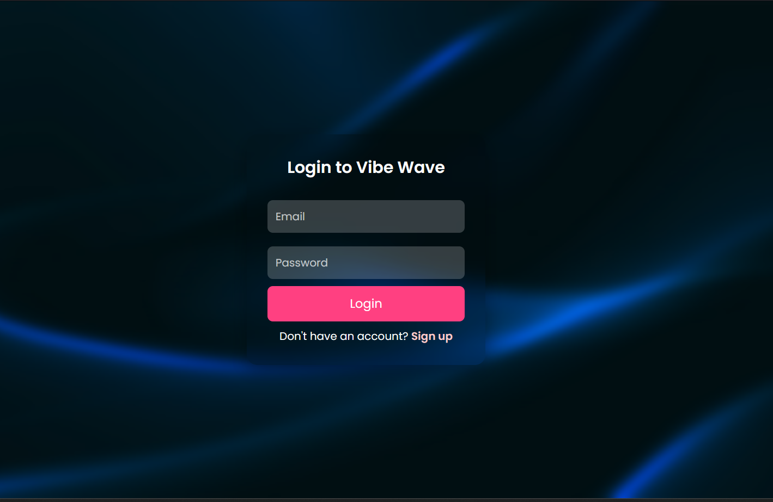
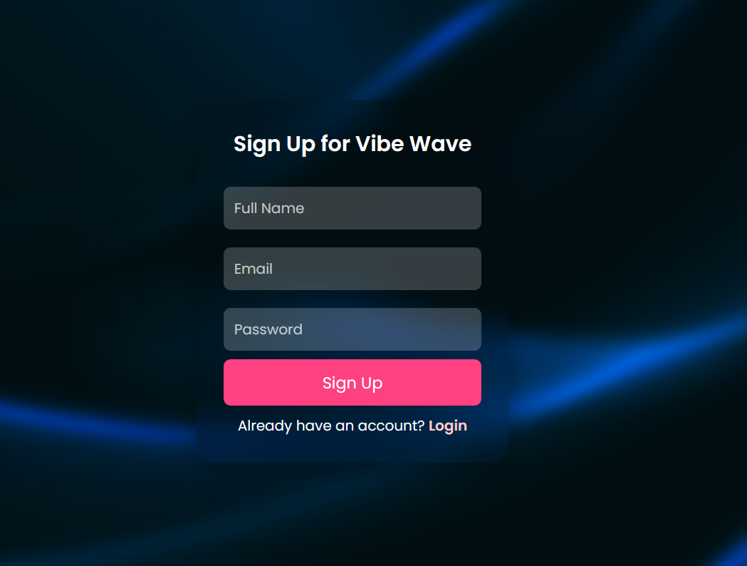
screenshots
LOGIN PAGE
SIGNUP PAGE

Slide 9
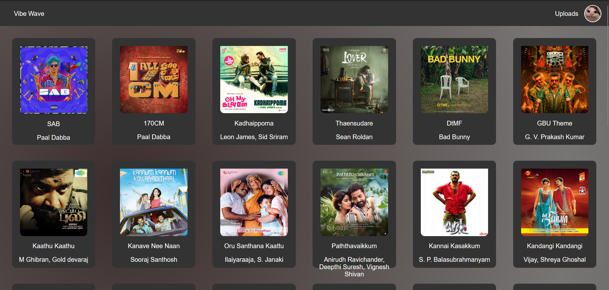
DASHBOARD

Slide 10
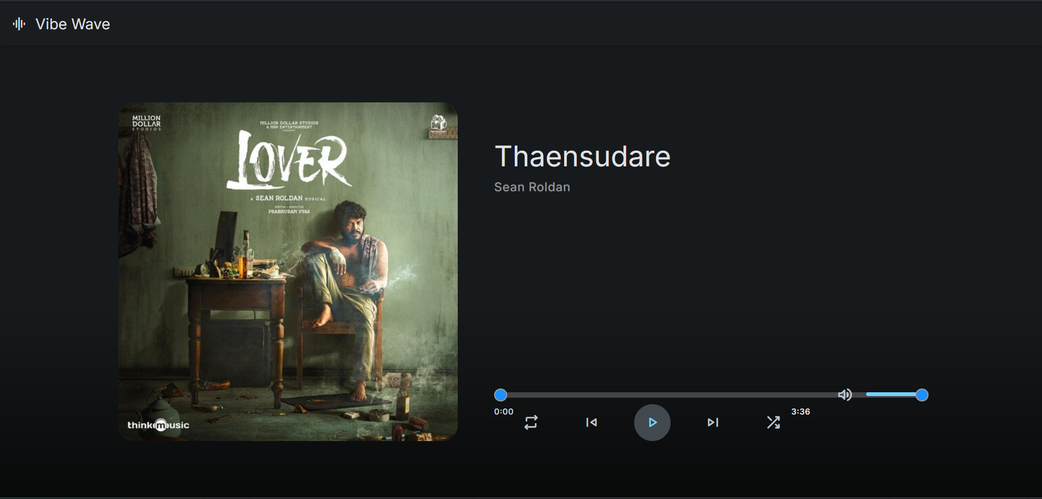
Music PAGE

Slide 11
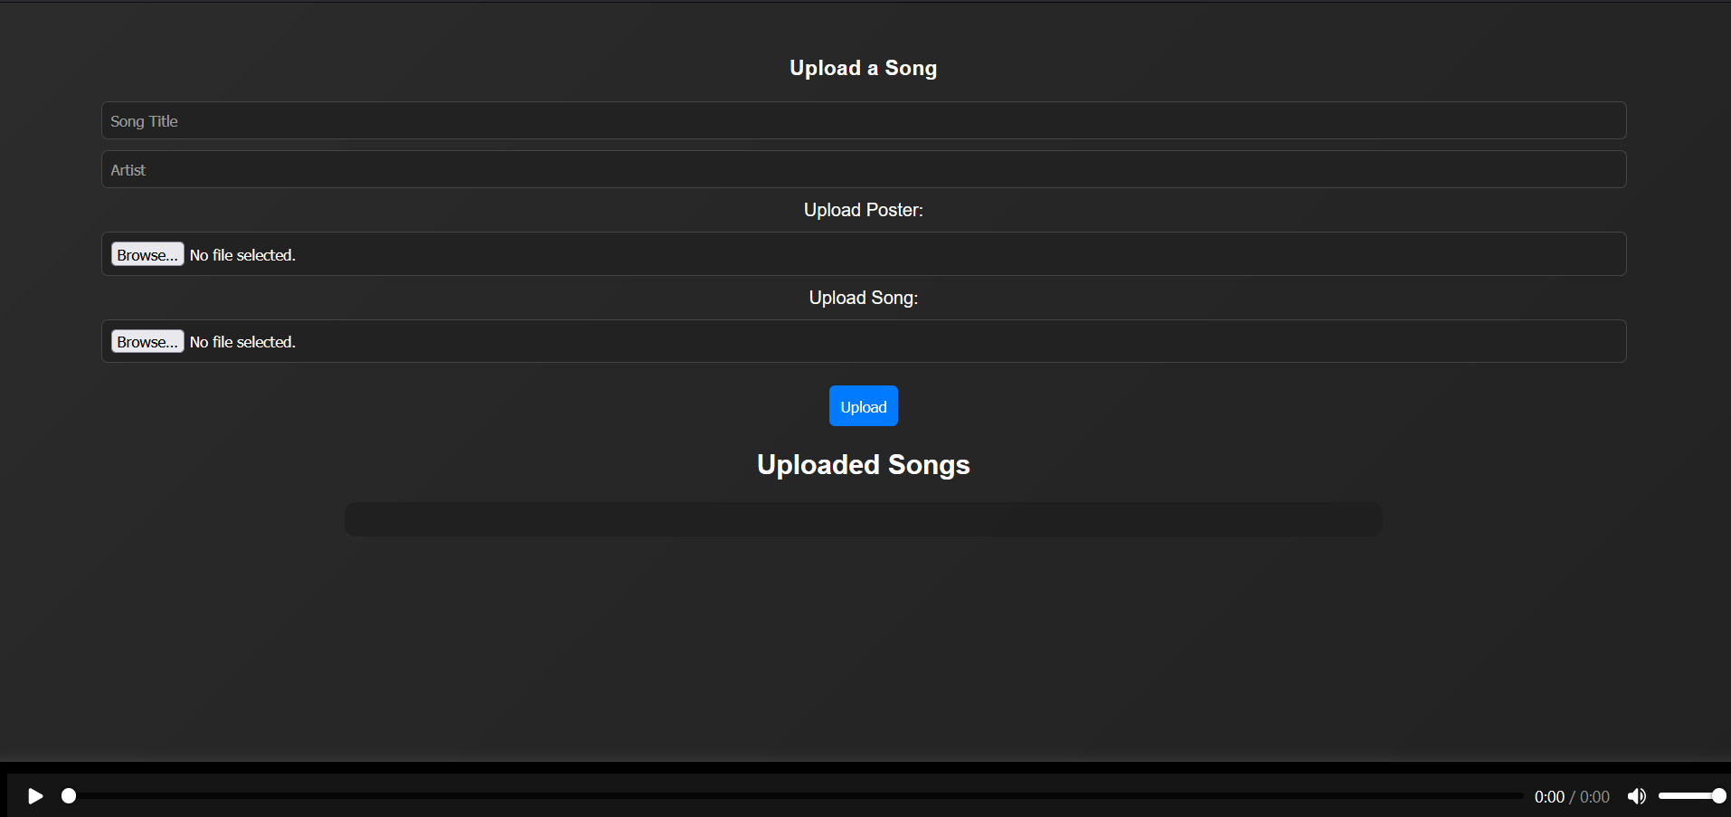
SONG UPLOAD PAGE

Slide 12
CONCLUSION
Vibe Wave is a powerful and user-friendly music platform designed to give users complete control over their personal music collection. By integrating secure authentication, cloud storage, and seamless playback, it ensures easy access to music across devices. The project demonstrates the efficient use of web technologies like HTML, CSS, JavaScript, Python, and MongoDB to create a smooth and interactive user experience.

Slide 13
FUTURE ENHANCEMENTS
Offline Mode & Smart Downloads
Allow offline playback for downloaded songs.
Implement a smart download feature that automatically downloads favorite songs when on Wi-Fi.
Live Streaming & Virtual Concerts
Enable artists to live-stream performances directly from the platform.
Host virtual concerts and fan meetups with ticketed access.
Social & Community Features
Introduce a social feed where users can follow others, like, comment, and share songs.

Slide 14
Thank you

